Slide 2
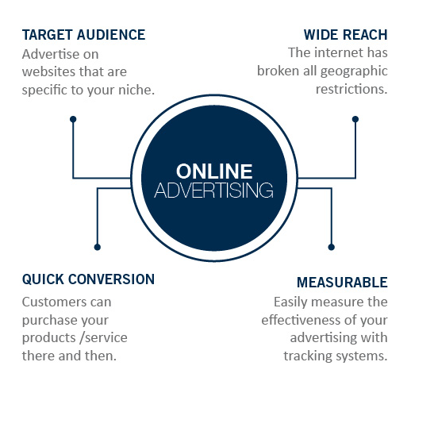
DIGITAL SOLUTIONS
Why advertise online

Slide 3
ONLINE TERMINOLOGY

Slide 4
ONLINE TERMINOLOGY
Unique browsers: The number of browsers who visit your site within a reporting period (usually one calendar month), recording each visitor only once (unique) regardless of how many times they visited your site in that period.
Impressions: The number of times an advertisement was viewed by browsers.
Pageviews: The number of times a web page was viewed by browsers.
Run of site: A run-of-site ad
is placed to rotate on all
non-featured ad spaces on
a website.
Run of network: A run-of-network ad is placed to run
on all websites within a network of sites.
CPM: CPM is "cost per thousand" ad impressions,
a standard industry measure
for selling ads on websites.
This measure is taken from
print advertising. The "M" is taken from the Roman numeral for "thousand".
Clickthrough rate:
The percentage of ad views
or impressions that resulted
in clickthroughs to the
target page.
Banner: An advertisement in the form of a graphic image that typically runs across a web page or is positioned in a margin or other space reserved for ads.

Slide 5
DIGITAL SOLUTIONS

Slide 6
WEBSITE
OVERVIEW
February 2019
WEBSITE | UNIQUE BROWSERS (SA AUDIENCE) | PAGEVIEWS (SA AUDIENCE) | FACEBOOK | TWITTER
TimesLIVE.co.za | 4 276 838 | 25 229 750 | 1 289 300 | 1 124 939
SowetanLIVE.co.za | 2 146 825 | 15 680 667 | 735 252 | 751 856
TshisaLIVE.co.za | 1 265 615 | 4 155 994 | 160 956 | 15 437
BusinessLIVE.co.za | 926 624 | 4 115 116 | 70 723 | 11 695
SundayTimes.co.za | 995 213 | 2 372 855 | 152 883 | 400 508
BusinessDay.co.za | 794 154 | 3 087 719 | 104 107 | 225 467
HeraldLIVE.co.za | 599 034 | 2 468 946 | 246 772 | 44 642
SundayWorld.co.za | 627 810 | 2 250 917 | 168 937 | 133 297
DispatchLIVE.co.za | 475 775 | 1 248 657 | 161 355 | 52 050
FinancialMail.co.za | 153 046 | 328 903 | 74 659 | 74 737
TimesSelect.co.za | 181 829 | 571 124 | 1 035 | 1 134
TimesLIVE.co.za/motoring | 78 726 | 124 598 | 22 515 | 6 686
SAHomeOwner.co.za | 23 641 | 55 273 | 240 690 | 8 318
WantedOnline.co.za | 22 869 | 38 689 | 116 734 | 677
TheHomeChannel.co.za | 7 574 | 30 613 | 10 185 | 2 378
Source: Narratiive; social media figures as at March 11 2019
RDM.co.za | 154 168 | 303 110 | 43 349 | 24 160
SAHomeOwner.co.za | 17 568 | 48 890 | 224 321 | 8 175

Slide 7
OUR NETWORK

Slide 8
OUR NETWORK
Here’s how our five biggest websites are put together – excluding external content partners, such as the Financial Times on BusinessLIVE
MOTORING
NATIONAL
FOCUS
SESSIONS
BY HOUR
EASTERN CAPE
FOCUS

Slide 9
OUR NETWORK
SA AUDIENCE: 76.8%
UNIQUE BROWSERS
926 624
PAGEVIEWS
4 115 116
 |  | INDEX
GAUTENG: | 42.9% | 110
WESTERN CAPE: | 17.2% | 126
KWAZULU-NATAL: | 13.3% | 81
EASTERN CAPE: | 6.8% | 90
LIMPOPO: | 6.4% | 83
BusinessLIVE delivers the best of Tiso Blackstar’s financial, business and political news, analysis and insight all day with original, online-only content as well as articles from its member titles – Business Day, the Financial Mail, the Sunday Times’s Business Times, Rand Daily Mail and Business Day TV, each with a devoted site within BusinessLIVE.
Subscribers enjoy exclusive original content, daily Financial Times articles, digital access to Times Select, and Morningstar financial data.
MALE | FEMALE
63% | 37%
15-19 | 20-24 | 25-34 | 35-44
9% | 14% | 23% | 20%
45-49 | 50-54 | 55-59 | 60+
11% | 5% | 11% | 7%
70 723 | 11 695
MOST-READ SECTIONS
Companies
Markets
Market Data
30.2%
69.8%
SESSIONS BY HOUR
AVG TIME ON SITE
2:33
SESSIONS
BY HOUR
Peak time: 5am – 10pm
www.businesslive.co.za
Source: Narratiive, Google Analytics

Slide 10
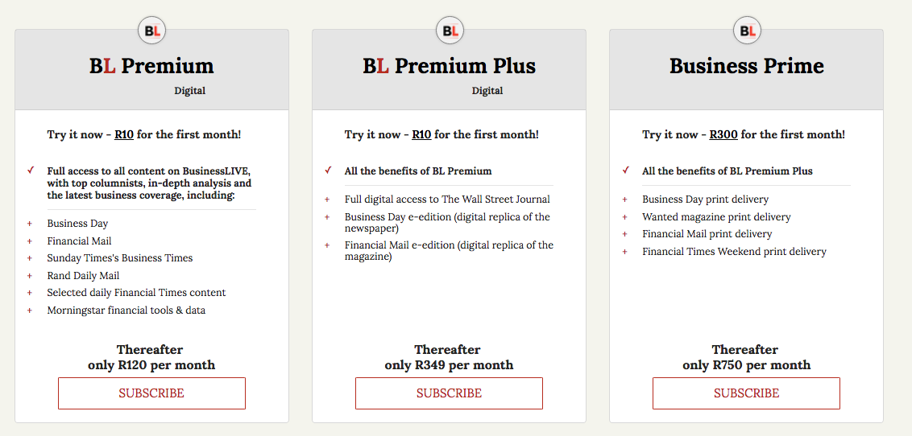
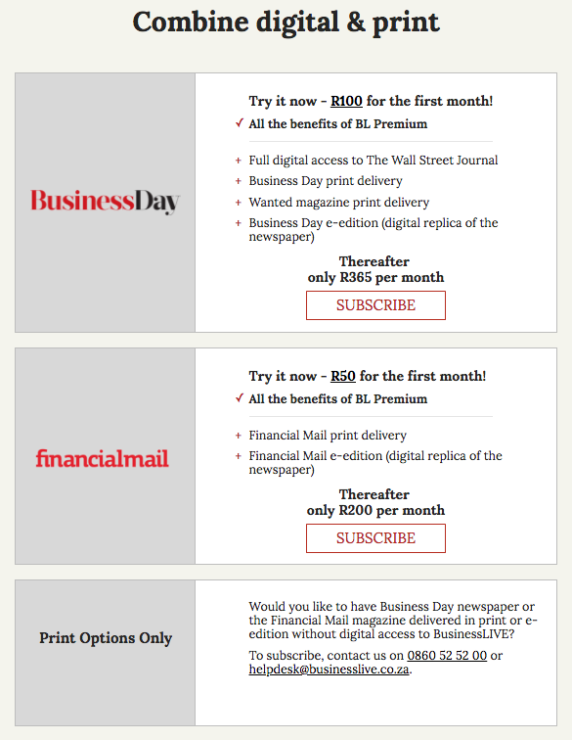
OUR NETWORK
BUSINESSLIVE SUBSCRIPTIONS
BusinessLIVE delivers the best of Tiso Blackstar’s financial, business and political news, analysis and insight all day with original, online-only content as well as articles from its member titles – Business Day, the Financial Mail, the Sunday Times’s Business Times, Rand Daily Mail and Business Day TV, each with a devoted site within BusinessLIVE.
Subscribers enjoy exclusive original content, daily Financial Times articles, digital access to Times Select, and Morningstar financial data.
SESSIONS
BY HOUR
www.businesslive.co.za

Slide 11
OUR NETWORK
SA AUDIENCE: 71%
UNIQUE BROWSERS
794 154
PAGEVIEWS
3 087 719
 |  | INDEX
GAUTENG: | 42.6% | 109
WESTERN CAPE: | 17.3% | 129
KWAZULU-NATAL: | 13% | 79
EASTERN CAPE: | 7% | 92
LIMPOPO: | 6.1% | 8793
Business Day prides itself on delivering current and concise economic information targeted at South Africa’s business community.
The website provides round-the-clock coverage of the best business news and in-depth analysis of the political economy, markets, a range of industries and much more.
It is housed within the broader BusinessLIVE website that presents the best of Tiso Blackstar’s business content.
MALE | FEMALE
63% | 37%
15-19 | 20-24 | 25-34 | 35-44
8% | 13% | 22% | 20%
45-49 | 50-54 | 55-59 | 60+
11% | 6% | 12% | 8%
104 107 | 225 467
MOST-READ SECTIONS
Companies
Markets
National
29.9%
70.1%
SESSIONS BY HOUR
AVG TIME ON SITE
2:53
SESSIONS
BY HOUR
Peak time: 5am – 10pm
www.businessday.co.za
Source: Narratiive, Google Analytics

Slide 12
OUR NETWORK
SA AUDIENCE: 78.9%
UNIQUE BROWSERS
153 046
PAGEVIEWS
328 903
 |  | INDEX
GAUTENG: | 47.4% | 121
WESTERN CAPE: | 21.3% | 156
KWAZULU-NATAL: | 10% | 61
EASTERN CAPE: | 4.9% | 65
LIMPOPO: | 4.6% | 59
One of South Africa’s most trusted financial magazines delivers weekly comprehensive news and analysis spanning investment, business, financial services, politics and social trends within the business sector.
The website publishes all magazine content along with online-only news and features.
It is housed within the broader BusinessLIVE website that presents the best of Tiso Blackstar’s business content.
MALE | FEMALE
66% | 34%
15-19 | 20-24 | 25-34 | 35-44
11% | 10% | 22% | 16%
45-49 | 50-54 | 55-59 | 60+
12% | 6% | 14% | 9%
74 659 | 74 737
MOST-READ SECTIONS
Money & investing
Opinion
News & Fox
30.2%
69.8%
SESSIONS BY HOUR
AVG TIME ON SITE
3:33
SESSIONS
BY HOUR
Peak time: 6am – 6pm
www.financialmail.co.za
Source: Narratiive, Google Analytics

Slide 13
OUR NETWORK
SA AUDIENCE: 86.4%
UNIQUE BROWSERS
175 766
PAGEVIEWS
270 016
 |  | INDEX
GAUTENG: | 42.9% | 112
KWAZULU-NATAL: | 14.4% | 87
WESTERN CAPE: | 14.2% | 104
EASTERN CAPE: | 7.4% | 98
LIMPOPO: | 7% | 91
The Sunday Times’s
Business Times section
delves into the week’s business news in
considerable depth,
with plenty of expert
analysis and opinion.
All Business Times articles
are listed on both the
Sunday Times website
under “Business” and
in the BusinessLIVE
section devoted to
Business Times.
MALE | FEMALE
57% | 43%
15-19 | 20-24 | 25-34 | 35-44
8% | 14% | 24% | 21%
45-49 | 50-54 | 55-59 | 60+
11% | 5% | 10% | 7%
Uses BusinessLIVE account | Uses BusinessLIVE account
MOST-READ SECTIONS
Business & economy
Money
Opinion
22.1%
77.9%
SESSIONS BY HOUR
AVG TIME ON SITE
3:07
SESSIONS
BY HOUR
Peak time: 5am – 6pm
www.businesstimes.co.za
Source: Narratiive, Google Analytics

Slide 14
OUR NETWORK
SA AUDIENCE: 81.6%
UNIQUE BROWSERS
4 276 838
PAGEVIEWS
25 229 750
 |  | INDEX
GAUTENG: | 43% | 110
KWAZULU-NATAL: | 15% | 91
WESTERN CAPE: | 12% | 91
LIMPOPO: | 8% | 109
EASTERN CAPE: | 7% | 95
South Africa’s second-biggest news website delivers original, online-only breaking and in-depth news, analysis, opinion, sport and
more around the clock, along with sizzling hot celebrity and entertainment news from
our TshisaLIVE team and the best of Tiso Blackstar motoring.
It also sources content from the print edition of the Sunday Times and includes the Times Select daily digital edition (each of these in a separate section for subscribers).
MALE | FEMALE
52% | 48%
15-19 | 20-24 | 25-34 | 35-44
10% | 22% | 32% | 17%
45-49 | 50-54 | 55-59 | 60+
7% | 3% | 6% | 3%
1 289 300 | 1 124 939
MOST-READ SECTIONS
News
Politics
Entertainment (TshisaLIVE)
20%
80%
SESSIONS BY HOUR
AVG TIME ON SITE
2:13
SESSIONS
BY HOUR
Peak time: 5am – 11pm
www.timeslive.co.za
Source: Narratiive, Google Analytics

Slide 15
OUR NETWORK
SA AUDIENCE: 77.8%
UNIQUE BROWSERS
78 726
PAGEVIEWS
124 598
 |  | INDEX
GAUTENG: | 38.8% | 99
KWAZULU-NATAL: | 16.1% | 98
LIMPOPO: | 10.6% | 138
WESTERN CAPE: | 10.4% | 76
EASTERN CAPE: | 8.2% | 108
The TimesLIVE motoring section publishes daily news and reviews from the world of cars and those who love to drive them. The section is presented in cooperation with Ignition, Tiso Blackstar Group’s popular motoring TV channel, and includes videos, TV highlights and an events guide.
MALE | FEMALE
80% | 20%
15-19 | 20-24 | 25-34 | 35-44
10% | 18% | 20% | 19%
45-49 | 50-54 | 55-59 | 60+
11% | 6% | 9% | 7%
22 515 (IgnitionLIVE) | 6 686 (IgnitionLIVE)
MOST-READ SECTIONS
New Models
News
Features
29.4%
70.6%
Also uses TimesLIVE accounts
SESSIONS BY HOUR
AVG TIME ON SITE
1:45
SESSIONS
BY HOUR
Peak time: 4.30am – 10.30pm
MOTORING
www.timeslive.co.za/ motoring
Source: Narratiive, Google Analytics

Slide 16
OUR NETWORK
SA AUDIENCE: 87.6%
UNIQUE BROWSERS
1 265 615
PAGEVIEWS
4 155 994
 |  | INDEX
GAUTENG: | 45.5% | 117
KWAZULU-NATAL: | 14.5% | 88
WESTERN CAPE: | 10.3% | 75
LIMPOPO: | 8.2% | 110
EASTERN CAPE: | 7.4% | 94
TshisaLIVE is the entertainment brand of TimesLIVE – South Africa’s top source of the hottest entertainment news and celebrity gossip, updated around the clock.
MALE | FEMALE
46% | 54%
15-19 | 20-24 | 25-34 | 35-44
10% | 18% | 30% | 19%
45-49 | 50-54 | 55-59 | 60+
8.3% | 4% | 6% | 5%
160 956 | 15 437
MOST-READ SECTIONS
TshisaLIVE
17.3%
92.7%
SESSIONS BY HOUR
AVG TIME ON SITE
2:11
SESSIONS
BY HOUR
Peak time: 5.30am – 10pm
www.timeslive.co.za/tshisa-live
Source: Narratiive, Google Analytics

Slide 17
OUR NETWORK
SA AUDIENCE: 82.9%
UNIQUE BROWSERS
995 213
PAGEVIEWS
2 372 885
 |  | INDEX
GAUTENG: | 43.9% | 112
KWAZULU-NATAL: | 14.4% | 87
WESTERN CAPE: | 14.2% | 104
EASTERN CAPE: | 7.4% | 98
LIMPOPO: | 7% | 95
The Sunday Times, South Africa’s premier Sunday newspaper and a favourite brand among South Africans for its fearless brand of investigate journalism, has its own section within TimesLIVE for its subscribers.
It publishes content from the popular Sunday Times newspaper as well as free, online-only news and features throughout the week.
MALE | FEMALE
57% | 43%
15-19 | 20-24 | 25-34 | 35-44
8% | 14% | 24% | 21%
45-49 | 50-54 | 55-59 | 60+
11% | 5% | 10% | 7%
152 883 | 400 508
MOST-READ SECTIONS
News
Lifestyle
Business
22.1%
77.9%
SESSIONS BY HOUR
AVG TIME ON SITE
1:47
SESSIONS
BY HOUR
Peak time: 5am – 10pm
www.sundaytimes.co.za
Source: Narratiive, Google Analytics

Slide 18
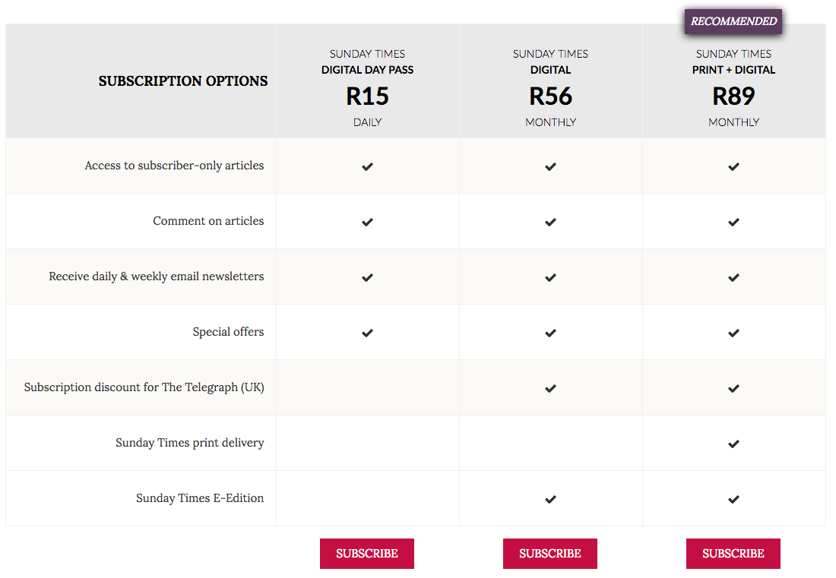
OUR NETWORK
SUNDAY TIMES SUBSCRIPTIONS
The Sunday Times, South Africa’s premier Sunday newspaper and a favourite brand among South Africans for its fearless brand of investigate journalism, has its own section within TimesLIVE for its subscribers.
It publishes content from the popular Sunday Times newspaper as well as free, online-only news and features throughout the week.
SESSIONS
BY HOUR
www.sundaytimes.co.za

Slide 19
OUR NETWORK
SA AUDIENCE: 79.8%
UNIQUE BROWSERS
376 418
PAGEVIEWS
617 785
 |  | INDEX
GAUTENG: | 43.9% | 112
KWAZULU-NATAL: | 14.4% | 87
WESTERN CAPE: | 14.2% | 104
EASTERN CAPE: | 7.4% | 98
FREE STATE: | 6% | 75
The Sunday Times’s Lifestyle section sets the trend in SA when it comes to matters of food, travel, fashion, books, health, sex, home and gardening, and much more.
MALE | FEMALE
57% | 43%
15-19 | 20-24 | 25-34 | 35-44
8% | 14% | 23% | 21%
45-49 | 50-54 | 55-59 | 60+
11% | 5% | 10% | 7%
Uses Sunday Times account | Uses Sunday Times account
MOST-READ SECTIONS
Lifestyle
Travel
Home & Gardening
22.2%
77.8%
SESSIONS BY HOUR
AVG TIME ON SITE
3:18
SESSIONS
BY HOUR
Peak time: 5am – 10.30pm
LIFESTYLE
www.timeslive.co.za/ sundaytimes/lifestyle
Source: Narratiive, Google Analytics

Slide 20
OUR NETWORK
SA AUDIENCE: 89.7%
UNIQUE BROWSERS
181 269
PAGEVIEWS
571 124
 |  | INDEX
GAUTENG: | 41.4% | 106
KWAZULU-NATAL: | 14.8% | 90
WESTERN CAPE: | 12.4% | 91
LIMPOPO: | 8.7% | 113
EASTERN CAPE: | 7% | 105
Times Select is South Africa’s first digital daily edition. Every weekday at 5am, we publish an expertly curated package of in-depth news and incisive commentary to get you up to date for the day ahead.
Times Select, which forms part of TimesLIVE, is reserved for subscribers only (Sunday Times subscribers enjoy free access).
MALE | FEMALE
50% | 50%
15-19 | 20-24 | 25-34 | 35-44
9% | 20% | 31% | 19%
45-49 | 50-54 | 55-59 | 60+
8% | 4% | 6% | 4%
1 035 | 1 134
MOST-READ SECTIONS
News
Editions
Ideas
37.5%
62.5%
SESSIONS BY HOUR
AVG TIME ON SITE
01:57
SESSIONS
BY HOUR
Peak time: 4.30am – 5pm
www.timesselect.co.za
Source: Narratiive, Google Analytics

Slide 21
OUR NETWORK
SA AUDIENCE: 87.4%
UNIQUE BROWSERS
2 146 825
PAGEVIEWS
15 680 667
 |  | INDEX
GAUTENG: | 45.7% | 117
KWAZULU-NATAL: | 12.7% | 77
LIMPOPO: | 10.8% | 140
WESTERN CAPE: | 8.6% | 63
EASTERN CAPE: | 6.7% | 88
The Sowetan newspaper has been part of the lives of South Africans since 1981, and online it delivers even more news and need- to-know information from the world of politics, comprehensive local soccer coverage, entertainment news and gossip, and consumer, relationship and lifestyle advice. It also includes the full Sunday World website.
MALE | FEMALE
55% | 45%
15-19 | 20-24 | 25-34 | 35-44
7% | 14% | 24% | 19%
45-49 | 50-54 | 55-59 | 60+
11% | 6% | 10% | 8%
735 252 | 751 856
MOST-READ SECTIONS
News
Entertainment
Sport
21.5%
78.5%
SESSIONS BY HOUR
AVG TIME ON SITE
2:34
SESSIONS
BY HOUR
Peak time: 5am – 10pm
www.sowetanlive.co.za
Source: Narratiive, Google Analytics

Slide 22
OUR NETWORK
SA AUDIENCE: 90.1%
UNIQUE BROWSERS
627 810
PAGEVIEWS
2 250 917
 |  | INDEX
GAUTENG: | 44.5% | 120
KWAZULU-NATAL: | 12.3% | 75
LIMPOPO: | 11.4% | 149
WESTERN CAPE: | 7.7% | 57
EASTERN CAPE: | 6% | 79
The website of the Sunday World tabloid newspaper, which forms part of SowetanLIVE, delivers celebrity and entertainment news and gossip, lively news reportage, superb sports coverage, and provocative but amusing stories that connect its readers to what’s happening around the corner, around the country and around the world.
MALE | FEMALE
58% | 42%
15-19 | 20-24 | 25-34 | 35-44
7% | 15% | 30% | 24%
45-49 | 50-54 | 55-59 | 60+
10% | 4% | 7% | 3%
168 937 | 133 297
MOST-READ SECTIONS
News
Shwashwi (gossip)
Lifestyle
23.9%
76.1%
SESSIONS BY HOUR
AVG TIME ON SITE
2:56
SESSIONS
BY HOUR
Peak time: 7am – 4pm
www.sundayworld.co.za
Source: Narratiive, Google Analytics

Slide 23
OUR NETWORK
SA AUDIENCE: 91.4%
UNIQUE BROWSERS
599 934
PAGEVIEWS
2 468 946
 |  | INDEX
EASTERN CAPE: | 35.4% | 469
GAUTENG: | 24.8% | 63
WESTERN CAPE: | 15.7% | 116
KWAZULU-NATAL: | 10.1% | 61
LIMPOPO: | 4.2% | 55
HeraldLIVE publishes all the local news worth knowing from Nelson Mandela Bay and surrounds in the Eastern Cape, along with relevant national and world news. Its mix of breaking news, analysis, entertainment, opinion and multimedia makes it the community’s favourite online news destination.
MALE | FEMALE
44% | 56%
15-19 | 20-24 | 25-34 | 35-44
9% | 11% | 22% | 18%
45-49 | 50-54 | 55-59 | 60+
11% | 6% | 12% | 11%
246 772 | 44 642
MOST-READ SECTIONS
News
Classifieds
Weekend Post
17.6%
82.4%
SESSIONS BY HOUR
AVG TIME ON SITE
2:06
SESSIONS
BY HOUR
Peak time: 6am – 4pm
www.heraldlive.co.za
Source: Narratiive, Google Analytics

Slide 24
OUR NETWORK
SA AUDIENCE: 90.6%
UNIQUE BROWSERS
475 775
PAGEVIEWS
1 248 657
 |  | INDEX
EASTERN CAPE: | 30.1% | 400
GAUTENG: | 29.8% | 76
WESTERN CAPE: | 14.2% | 104
KWAZULU-NATAL: | 12.1% | 74
LIMPOPO: | 4.5% | 58
DispatchLIVE is the prime source of local news in East London and surrounds in the Eastern Cape.
It publishes a mix of news, analysis, entertainment, opinion and multimedia throughout the day and has a devoted and engaged audience on Facebook and Twitter.
MALE | FEMALE
52% | 48%
15-19 | 20-24 | 25-34 | 35-44
9% | 14% | 27% | 20%
45-49 | 50-54 | 55-59 | 60+
10% | 5% | 9% | 6%
161 355 | 52 050
MOST-READ SECTIONS
News
Politics
Sport
17.9%
82.1%
SESSIONS BY HOUR
AVG TIME ON SITE
2:16
SESSIONS
BY HOUR
Peak time: 7am – 10pm
www.dispatchlive.co.za
Source: Narratiive, Google Analytics

Slide 25
OUR NETWORK
SA AUDIENCE: 39.5%
UNIQUE BROWSERS
7 574
PAGEVIEWS
30 613
 |  | INDEX
GAUTENG: | 57.8% | 148
WESTERN CAPE: | 14.7% | 108
MPUMALANGA: | 13% | 70
KWAZULU-NATAL: | 11.6% | 70
EASTERN CAPE: | 9.2% | 122
The Home Channel on DStv has its own website where it publishes content relating to decor, design, gardening, home improvements, property, food and more, tying in with its television shows and mixing the best of local and international content.
MALE | FEMALE
26% | 74%
15-19 | 20-24 | 25-34 | 35-44
10% | 21% | 32% | 17%
45-49 | 50-54 | 55-59 | 60+
7% | 3% | 6% | 3%
10 185 | 2 378
MOST-READ SECTIONS
TV Guide
Shows
Real Health
40%
60%
SESSIONS BY HOUR
AVG TIME ON SITE
1:34
SESSIONS
BY HOUR
Peak time: 6am – 10pm
www.thehomechannel.co.za
Source: Narratiive, Google Analytics

Slide 26
OUR NETWORK
SA AUDIENCE: 80.3%
UNIQUE BROWSERS
23 641
PAGEVIEWS
55 273
 |  | INDEX
GAUTENG: | 44.7% | 114
WESTERN CAPE: | 16.9% | 92
KWAZULU-NATAL: | 14.2% | 129
EASTERN CAPE: | 6.2% | 152
MPUMALANGA: | 5.9% | 76
SA Home Owner is a popular reference guide to ideas, inspiration, information and innovation in home, design and decor.
It offers insights into beautiful properties, updates readers on local and international trends, and shares practical supplier information.
MALE | FEMALE
49% | 51%
15-19 | 20-24 | 25-34 | 35-44
3% | 19% | 25% | 22%
45-49 | 50-54 | 55-59 | 60+
14% | 5% | 7% | 5%
249 690 | 8 318
MOST-READ SECTIONS
Featured homes
Kitchens
Ask the experts
32.2%
67.8%
SESSIONS BY HOUR
AVG TIME ON SITE
1:25
SESSIONS
BY HOUR
Peak time: 8am – 5pm
www.sahomeowner.co.za
Source: Narratiive, Google Analytics

Slide 27
OUR NETWORK
SA AUDIENCE: 75.4%
UNIQUE BROWSERS
22 869
PAGEVIEWS
38 689
 |  | INDEX
GAUTENG: | 47.8% | 122
WESTERN CAPE: | 27.4% | 202
EASTERN CAPE: | 11% | 146
KWAZULU-NATAL: | 6.8% | 41
MPUMALANGA: | 3.2% | 49
Wanted Online, the stylish website of the award-winning monthly Wanted magazine distributed to Business Day readers, publishes fresh daily content aimed at South Africa’s niche luxury market. Cars, watches, jewellery, travel, gadgets, society, style, fine dining and more – we have it covered.
MALE | FEMALE
33% | 67%
20-24 | 25-34 | 35-44
5% | 22% | 18%
45-49 | 50-54 | 55-59 | 60+
10% | 9% | 17% | 19%
116 734 | 677
MOST-READ SECTIONS
Voices
Art & design
Cars, bikes & boats
27.7%
72.7%
SESSIONS BY HOUR
AVG TIME ON SITE
2:20
SESSIONS
BY HOUR
Peak time: 7am – 6pm
www.wantedonline.co.za
Source: Narratiive, Google Analytics

Slide 28
OUR NETWORK
OTHER APPS
Free-to-download app for iOS and Android, with a stylish design, reliable speed and user-friendliness.
Carries all content from Business Day’s website, including content reserved for BusinessLIVE Premium subscribers.
Mobile Apps
Free on iOS, Android; has all recent articles published on the SowetanLIVE website.
PDF reader for e-edition of magazine; free to download but for subscribers only.
+
This app for iOS and Android delivers free news all day and lets Sunday Times subscribers read SA’s best weekend content too.
Subscribers get the full daily edition at 5am – read it online or offline and complete the crossword (iOS or Android).
February 2019
4,998 active devices per day
355,229 sessions for the month
2,702 new devices joined
14,948 unique browsers

Slide 29
OUR NETWORK
Audience overlap
4.2m
926,654
4.2m
2.1m
546,738
1,256,114
10.5% of total audience
19.6% of total audience
598,808
475,775
124,304
11.6% of total audience
Source: Narratiive, February 2019

Slide 30
OUR NETWORK
SEM 8-10 (Socio-Economic Measure)
Universe size: 8,488,000
Number of readers
6,225k
1,479k
510k
High SEM
supergroup
readers: Where do you
read your news?
Paper
only
73%
Paper
& online
21%
Online
only
6%
Avg monthly income
R22,508
42 years
R30,348
36 years
R30,337
36 years
Avg age
Source: PAMS 2017

Slide 31
AD SPACES

Slide 32
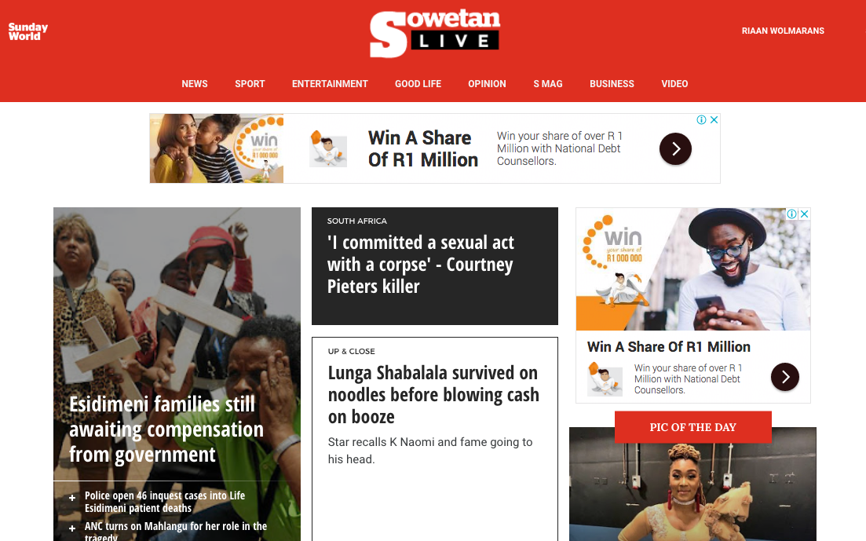
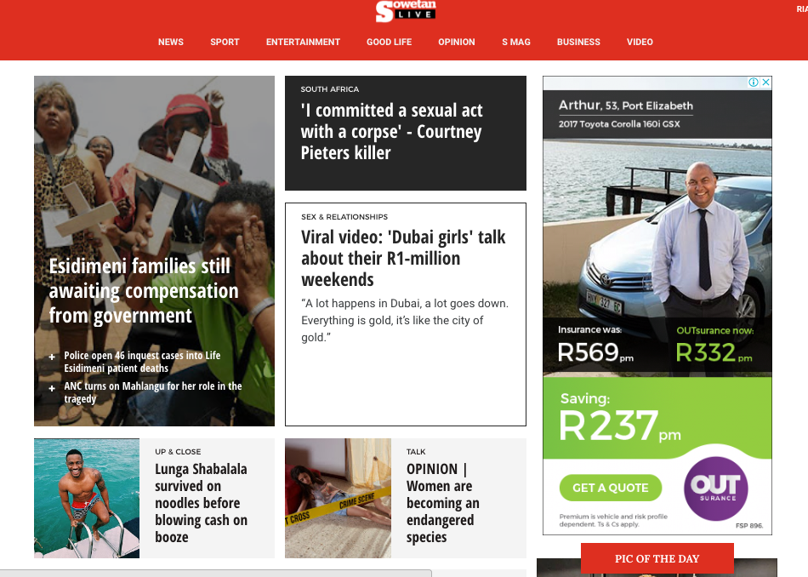
AD SPACES
AD BOX
300 x 250
Standard banner ADS
HALF PAGE AD
300 x 600

Slide 33
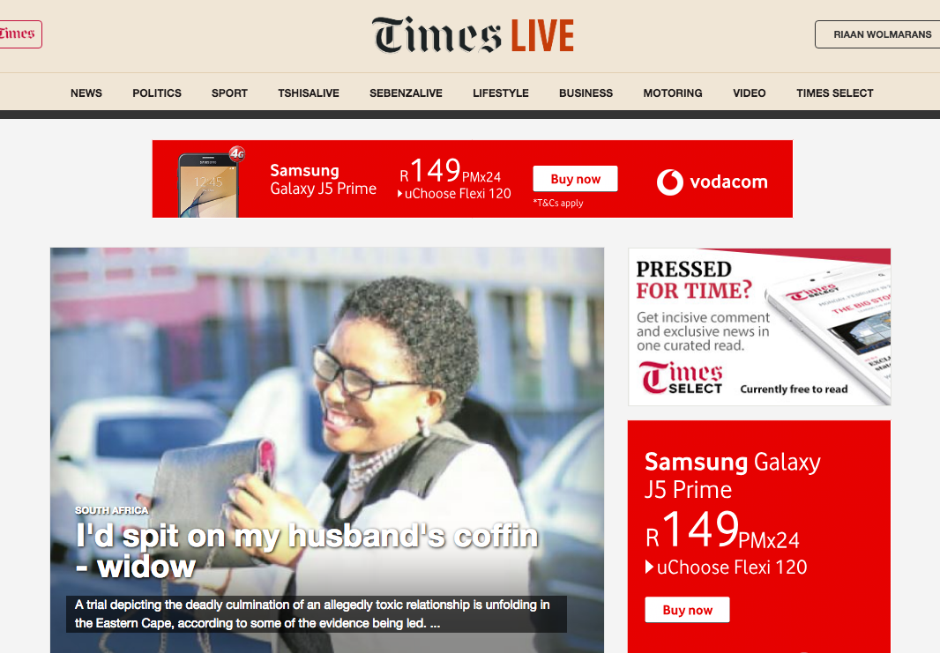
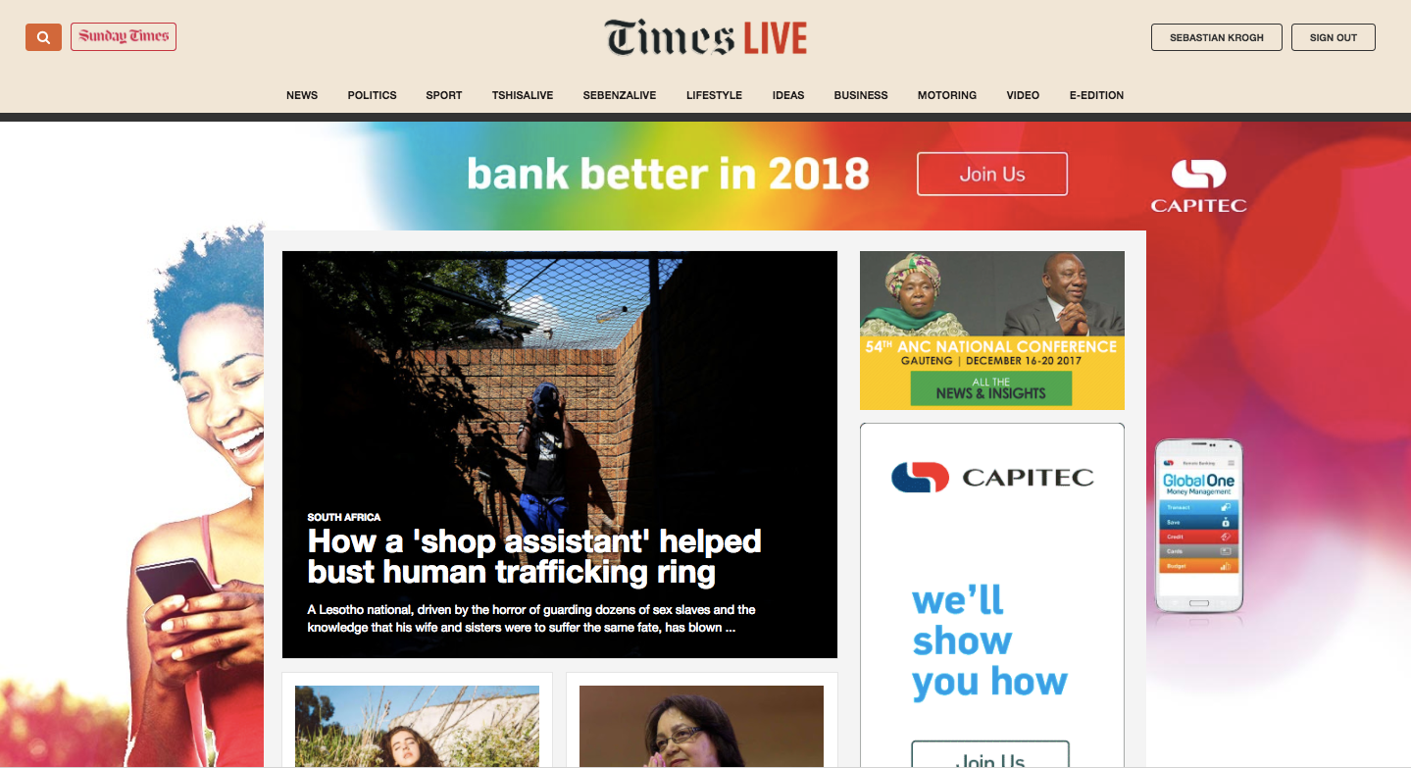
AD SPACES
LEADERBOARD
728 x 90
Standard banner ADS
BILLBOARD
1000 x 250

Slide 34
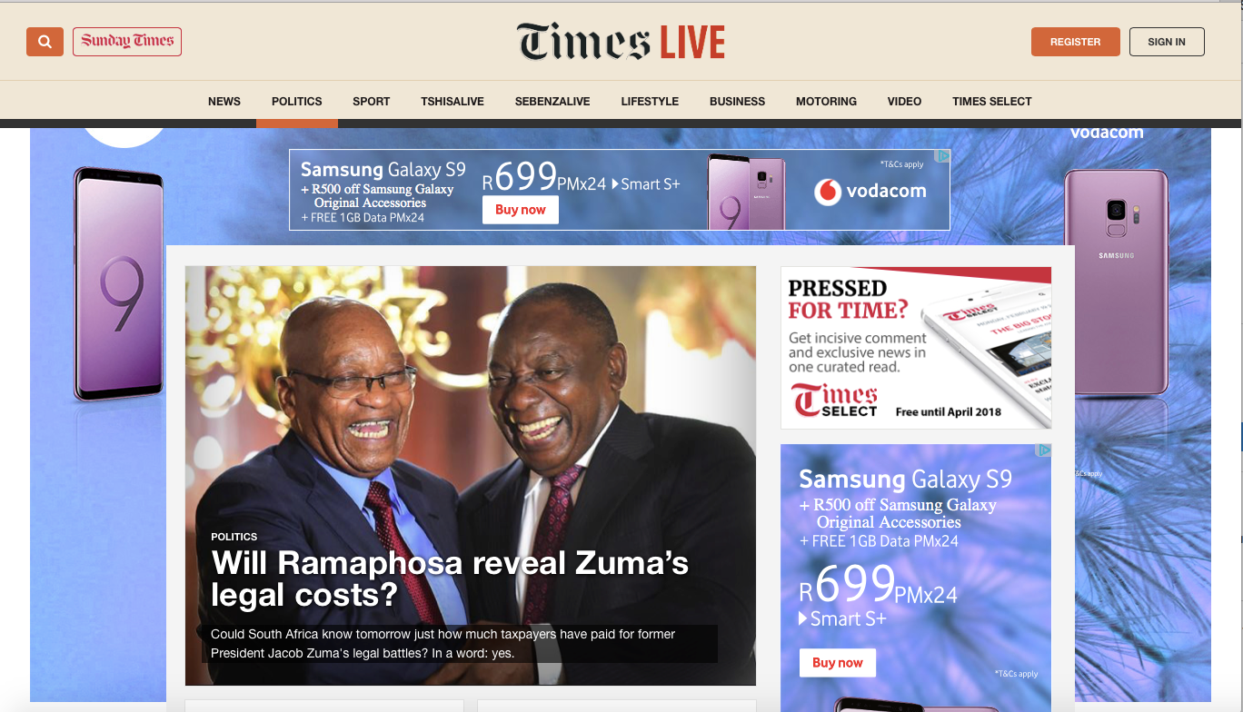
AD SPACES
HOME-PAGE TAKEOVER
Standard banner ADS

Slide 35
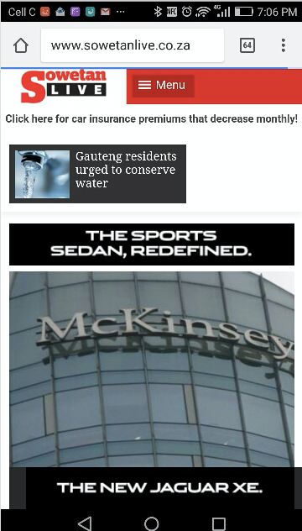
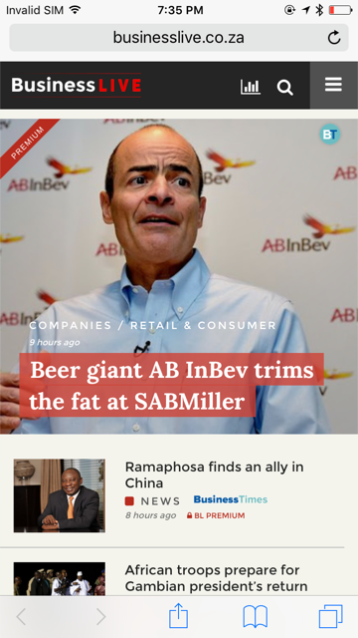
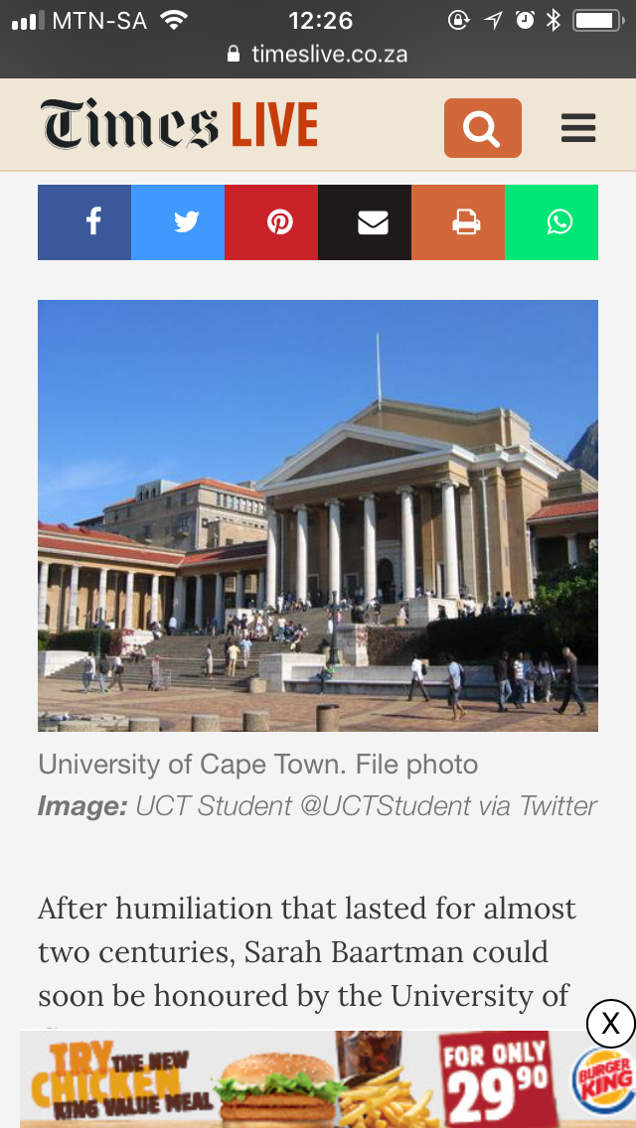
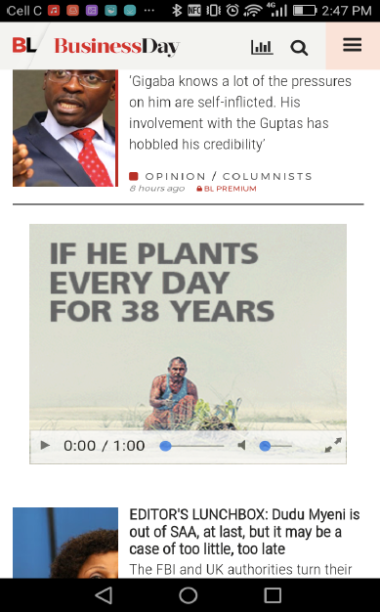
300 x 250
320 x 50
AD SPACES
Mobile advertising

Slide 36
320 x 100
AD SPACES
Mobile advertising

Slide 37
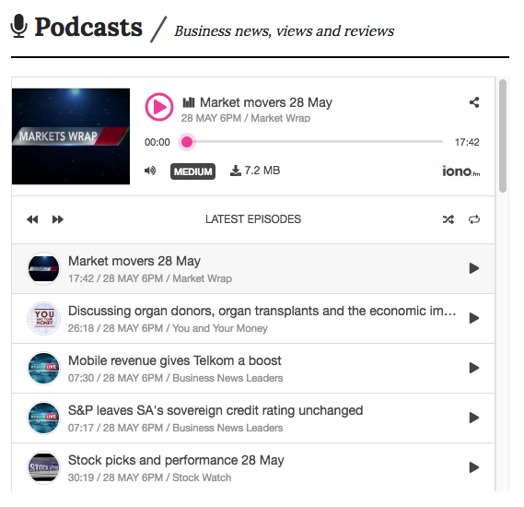
AD SPACES
Podcasts
Tiso Blackstar Group publishes a range of podcasts, ranging from business topics (in partnership with Business Day TV) to specialist podcast series on topics like political events.
Advertising opportunities on podcasts include sponsorships and audio pre-, post- and mid-roll advertisements.
35,459
Average number of podcast downloads across Tiso Blackstar Group platforms (February 2019)

Slide 38
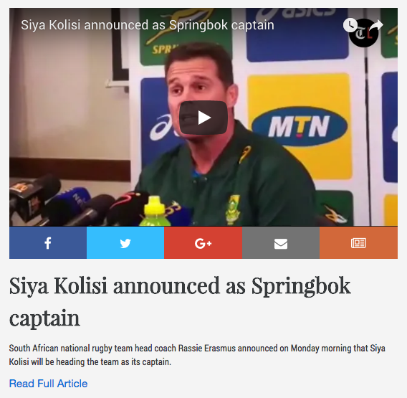
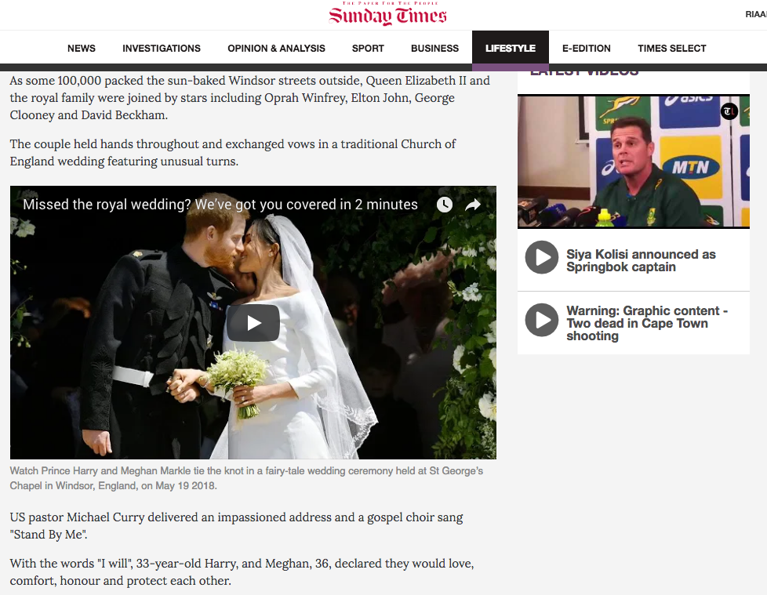
AD SPACES
Video
Tiso Blackstar Group publishes many hours of video every month across our websites – breaking news videos, lifestyle news and features, exclusive interviews, in-depth news analysis and more.
We offer pre-roll advertising on these videos, as well as sponsorships.
5.7-million
Total video views of Tiso Blackstar Group content across our websites, Facebook and YouTube (February 2019)

Slide 39
AD SPACES
WHAT WE OFFER
Private marketplace deals are attractive because they bridge the best aspects of traditional direct sales and programmatic. Key benefits of programmatic advertising include an automated workflow that adds tremendous efficiencies to a sales process; the ability to target specific audiences in real time; and the evaluation, targeting and customisation of ad creative for each impression.
Tiso Blackstar Group offers you a universe of more than 7-million unique browsers.
Target your advertising in a more granular way by buying audiences rather than sites.
Plug directly into our inventory source in a safe and secure environment.
Gain access to our premium inventory before it is made available to open auctions.
Programmatic advertising

Slide 40
AD SPACES
PMP audiences (first-party data)
In addition to standard IAB audience segments, through Cxense and Enreach we can build customised audience segments. For example:
Programmatic advertising
Segment | Unique users | % of network | Pageviews
Active Outdoors & Nature | 66 000 | 0,9% | 300 000
Animal Lovers | 173 000 | 2,4% | 846 000
Business/Career | 363 000 | 5% | 4 300 000
Celebrities & Entertainment | 320 000 | 4,4% | 4 800 000
Children & Parenting | 420 000 | 5,8% | 4 400 000
Fashion & Beauty | 247 000 | 3,4% | 7 200 000
Food, Wine & Dining | 283 000 | 3,9% | 2 000 000
Gaming | 219 000 | 3% | 1 100 000
Health & Fitness | 276 000 | 3,8% | 1 600 000
Music Lovers | 383 000 | 5,3% | 5 300 000
Personal Finance & Economy | 468 000 | 6,4% | 6 500 000
Plants/Gardening | 144 000 | 2% | 766 000
Sports Followers | 275 000 | 3,8% | 4 500 000
Studying | 152 000 | 2,1% | 700 000
Style & Trendsetters | 196 000 | 2,7% | 1 100 000
Technology & Gadgets | 294 000 | 4% | 1 500 000
Thearte, Arts & Culture | 340 000 | 4,7% | 3 400 000
Weekends & Nightlife | 110 000 | 1,5% | 476 000
World Travel Enthusiasts | 338 000 | 4,6% | 2 500 000
Universe: 7.3-million monthly unique browsers

Slide 41
AD SPACES
WHAT IS NATIVE ADVERTISING?
Paid-for articles, infographics, videos and more presented similarly to regular editorial content, in the style of the hosting website. It provides value to readers by entertaining, informing or educating while raising awareness of a brand message or campaign.
TYPES OF NATIVE CONTENT
Sponsored (paid-for/branded)
Provided by the brand or created by Tiso Blackstar Group –custom-written in an editorially engaging way for maximum appeal to our readers.
Advertorial
Content presented by the brand to push a particular product or aspect of the brand itself (but such content often fails to attract readers’ attention).
Native advertising

Slide 42
AD SPACES
WHY DOES NATIVE ADVERTISING WORK?
Brands and advertisers love native content, mainly because clickthrough rates tend to be higher than for display advertising – and, if done right, it can lead to high reader engagement.
Sharethrough and IPG report that consumers engage with native content 53% more frequently than with traditional display ads. About 32% of survey respondents say they would share a native content with someone they know.
Why is this? According to Shareaholic, 70% of people want to learn about products through content rather than through traditional advertising. Furthermore, people view native content 53% more often than banner ads. Add rich media to the mix, and conversion rates can increase by up to 60%.
Native advertising

Slide 43
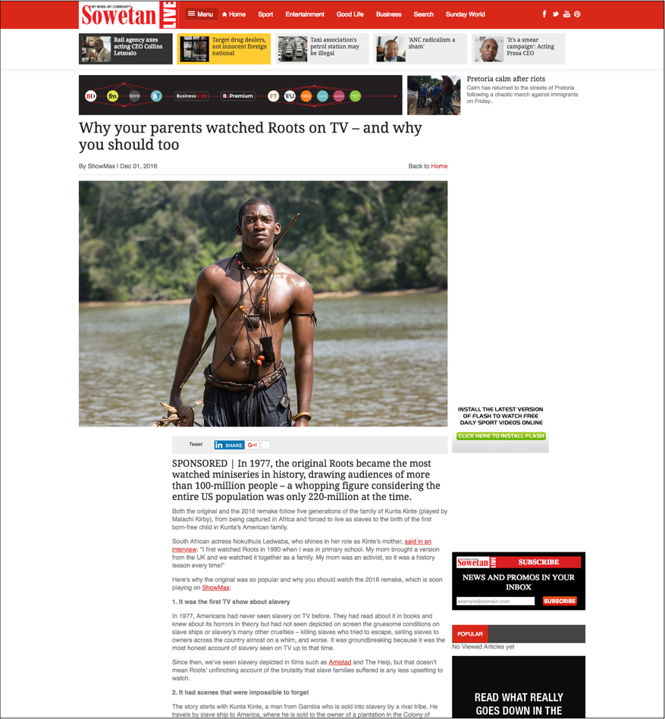
AD SPACES
CAMPAIGN EXAMPLE: Showmax on SowetanLIVE
The streaming internet TV service wanted to reach a young, aspirational class of readers starting to earn disposable income and interested in entertainment-related topics.
Native advertising
STRATEGY
Over a month, publish series of articles using cool ShowMax content to attract readers and teach them about internet TV.
Embed ShowMax marketing messages or calls to action in those articles.
Promote articles via paid Facebook campaign targeted at audience interested in TV and movies.
EXAMPLE: “Why your parents watched Roots on TV – and why you should too”
ShowMax got a high number of sign-ups and leads, and renewed the campaign.
With embedded calls to action…
And social
support…
Reach: 474,365
Impressions: 1,291,954
Clicks: 19,785

Slide 44
AD SPACES
CAMPAIGN EXAMPLE: Investec on BusinessLIVE
Investec wanted to connect with wealthy readers interested in investment and related financial topics, which fit the niche audience profile for BusinessLIVE.
Native advertising
STRATEGY
EXAMPLE: “Active or passive fund management: which is on the fast track?”
Over a year, publish a weekly series of informative articles written by Investec experts on matters relating to investment, retirement and other financial services.
Promote articles via Facebook & Twitter on BusinessLIVE and Business Day; share on Investec’s own social media channels; link previous content as related articles.
Investec has had 1000s of pageviews, associated with premium publisher; readers are educated on investment.
With embedded calls to action…
And social
support…

Slide 45
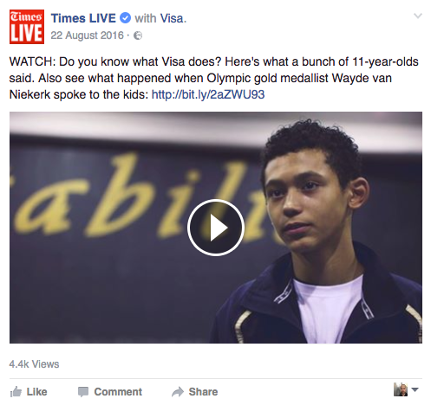
AD SPACES
CAMPAIGN EXAMPLE: Visa on TimesLIVE/Sunday Times
Visa filmed Olympic star Wayde van Niekerk talking to clever kids at his alma mater about motivation, credit cards and money, and made a series of cute short videos.
Native advertising
STRATEGY
Publish the series of five videos weekly on Facebook (right after Olympics) with paid promotion per post via the TimesLIVE Facebook page (with more than 1-million fans already).
Collect the videos and explanatory copy in an article published on the Sunday Times website and updated weekly with the latest video content.
“Five life lessons from Olympic champion Wayde van Niekerk”
Times Media delivered more than 100,000 video views for the Visa campaign.
Video posts

Slide 46
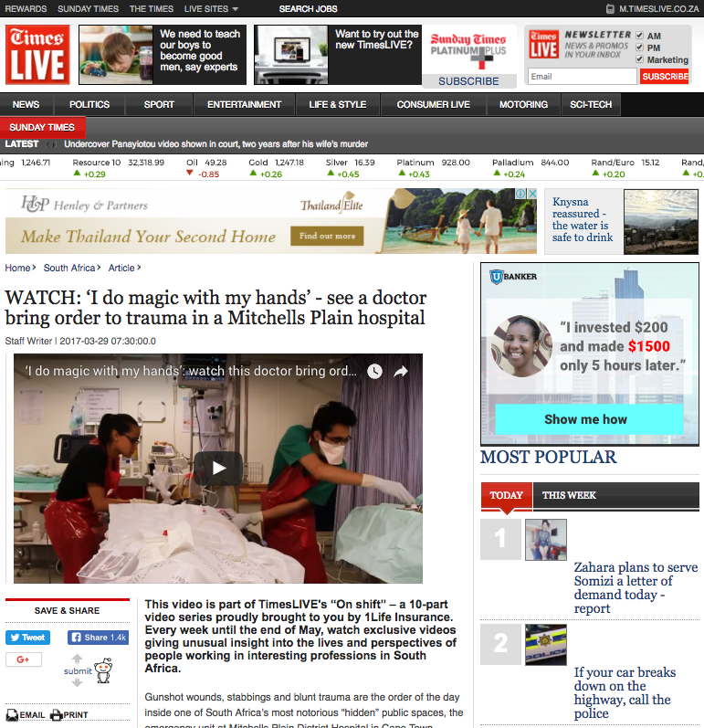
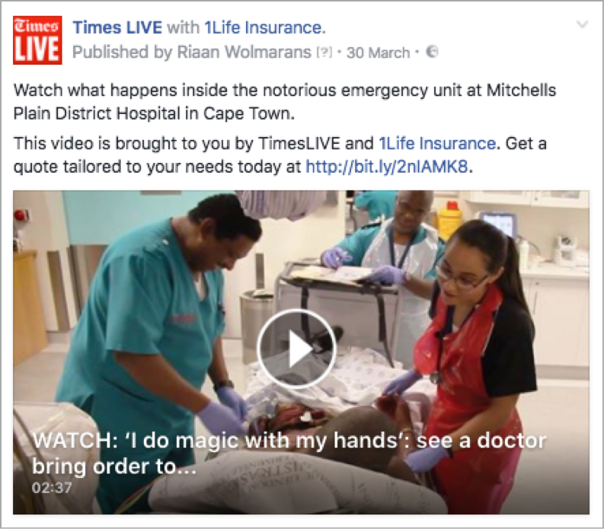
AD SPACES
CAMPAIGN EXAMPLE: 1Life on TimesLIVE
The insurer wanted to showcase its approach of “Changing lives”. TimesLIVE produced a series of 10 high-quality video features about ordinary South Africans changing others’ lives through their jobs.
Native advertising
STRATEGY
Publish the series of 10 videos over 10 weeks as video articles on YouTube and TimesLIVE, followed by native video publication on Facebook later in the week, with a targeted promotional campaign on Facebook to deliver the videos to a wider audience.
All videos on YouTube, TimesLIVE and Facebook
carried the 1Life logo and a 1Life call to action.
Example: video featured a doctor in the trauma unit of a Mitchells Plain hospital
Tiso Blackstar delivered more than 900,000 video views for the 1Life campaign.

Slide 47
THANK YOU

